Slide 1
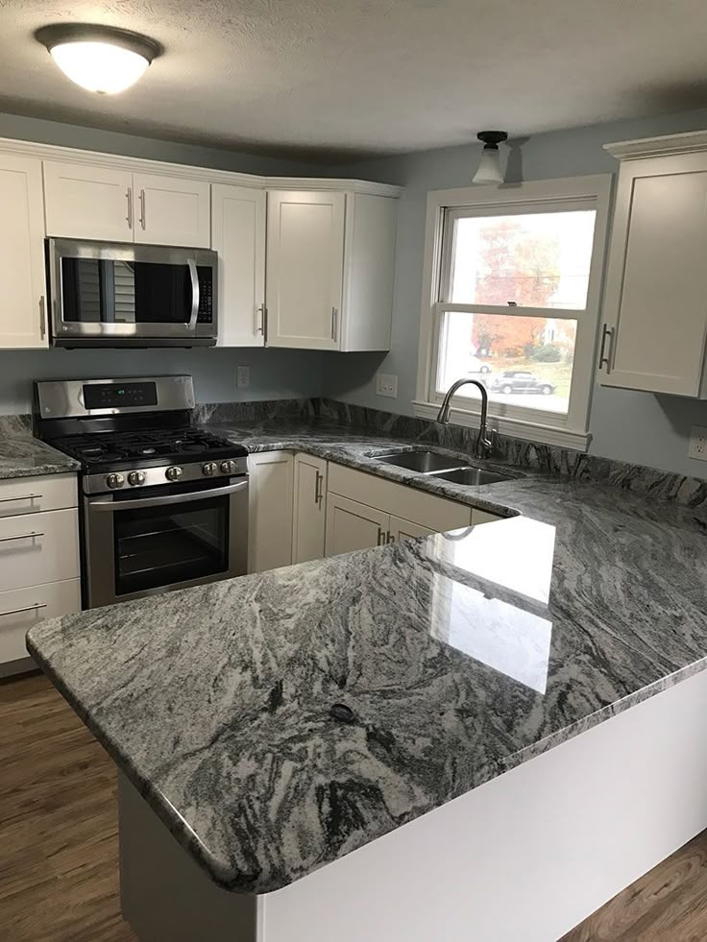
PERSONAL REVIEW
A Year in Review
Health, Home, and Family, 2025
Twelve months of steady habits: blood pressure trending down, six days a week of movement, and a kitchen finally worth cooking in.
Carlos Moore | Nashville, Tennessee

Slide 2
Blood Pressure, Held in Target
Monthly average, home readings, goal under 130 over 80
• Down and steady. Systolic fell from 134 to 128 over the year.
• Within goal. Held under 130 over 80 since the spring.
• What changed. Daily medication, less sodium, more walking.
• Yoga helped. Sleep and readings both improved after January.

Slide 3
Movement, Every Week
Total miles walked each month at Percy Warner Park
365
miles for the year
3x
walks per week
6
days a week of movement

Slide 4
Where the Card Went
2025 rewards card spending by category
• $11,409 total. Across the four tracked categories.
• Groceries lead. Heart healthy cooking at home most nights.
• Dining steady. Date nights and brunch with Tanya.
• Rewards earned. Paid in full every month, no interest.

Slide 5

Home and Life
A few projects that kept the house in good shape
Project | When | Cost
Patio sealant reapplication | May 2025 | DIY
Roof inspection after storms | September 2025 | $150
Chimney inspection and cleaning | October 2025 | $200
Water heater replacement | February 2026 | $1,240
Quarterly pest control | Ongoing | $89

Slide 6
Onward, steady as ever.
Goals for the year ahead: keep the readings in range, finish the recertification credits,
and hold the family rhythms that make the rest of it worth doing.
Reviewed February 2026, Nashville, Tennessee

